Slide 1
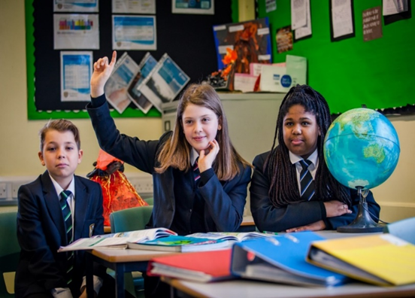
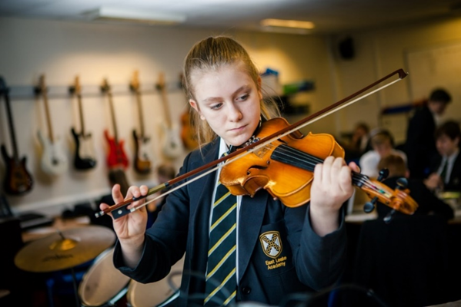
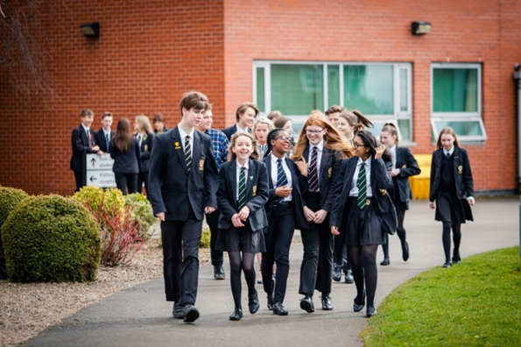
Welcome to our New Year 7s
We empower | We respect | We care

Slide 2
Vision
To inspire.
To raise aspirations.
To create brighter tomorrows.
We empower | We respect | We care

Slide 3
Mission
ELA is a world class academy that enables students to take advantage of every opportunity given to them and go beyond their aspirations.
We are driven by strong leadership, high performing teams and expert staff.
We empower | We respect | We care

Slide 4
Welcome to the start of your 7 year journey
We empower | We respect | We care

Slide 5
Introductions
Mr. Reid – Principal
Mrs. Baxter - Assistant Principal
Miss. Higgins – Y7 Pastoral Leader
Mrs Holroyd – Y7 Pastoral Assistant
Lily Ingham & Ethan Trencher – Head students
We empower | We respect | We care

Slide 6
Relationships – healthy & unhealthy
Physical health & well-being
Online safety
PDL curriculum
RPE (religion, philosophy, ethics)
Mental health & well-being
Living in the wider world
We empower | We respect | We care

Slide 7
Maths surgery
Sports clubs
DofE
Harry Potter
Warhammer
Hagg Farm
Enrichment
Ski Trip
Music
Paris Trip
Think Tank
Dungeons & dragons
Write club
We empower | We respect | We care

Slide 8
High expectations
Respect
Kindness
Uniform
Punctuality
Attendance
Attitude to learning
Wider academy life
We empower | We respect | We care

Slide 9
P16 Head students
We empower | We respect | We care

Slide 10
Welcome from Miss Higgins
We empower | We respect | We care

Slide 11
The transition process so far
Visited as many primary schools as possible and met our new students
Invited students into the academy who are joining us from non-feeder schools
Spoken to primary teachers/SENCos and completed detailed handovers
Distributed transition booklets to students – includes both pastoral and academic tasks – also available on our website
Hosted a small number of visits for students with additional needs
Sent postcards informing students of their tutor group and house
Invited all students to our face-to-face transition that will take place next week
We empower | We respect | We care

Slide 12
Transition Days 1st-3rd July 2024
Transport to and from school – Buses drop off in the car park, students will need money for public service buses – school buses know to expect Y6 students
The school day: 8:25am – 3:05pm
When you arrive to school on the first transition day, please drop students off at the gate so they can head straight into the social space (tennis courts at the front of school). Staff will be around to show them where to go.
Packed lunch/money (approximately £3), water bottle, sun cream/hat, jacket, equipment, transition workbook
You don’t need to wear school uniform on your transition days, please wear comfortable clothing and footwear that will be suitable for a variety of activities.
We empower | We respect | We care

Slide 13
Structure of the transition days
Monday 1st July | Tuesday 2nd July | Wednesday 3rd July
Arrive at ELA for about 8.25-8.25am Welcomed to the front of ELA and taken to your social space by staff for lineup Assembly PDL – time to get to know your tutor group and receive your timetable Transition Lessons | Start your day at lineup in your social space PDL Transition lessons Interhouse competition lead by our Heads of House | Start your day at lineup in your social space PDL Transition lessons Interhouse competition lead by our Heads of House – winning house awarded prizes! Closing celebration assembly
We empower | We respect | We care

Slide 14
A flying start – Wednesday 4th Sept
Staff will welcome students (Y7 & P16) to the academy from 8.15am – please check transport arrangements
Y7 students will go to their morning registration zone (tennis courts) and then be led to the main hall to be welcomed by Mr Reid, Miss Higgins & Y7 pastoral team
Students will spend extended time with their tutor
Students will get to experience the academy with reduced numbers
Students are welcome to bring a packed lunch or money to buy food from the canteen
Students will finish their day at 3.05pm and make their own way home (please check transport arrangements)
We empower | We respect | We care

Slide 15
How you can support
Talk about how you child might be feeling and explain the differences between primary and secondary (bigger site, new people, changing teachers etc)
Reassure them that nerves/anxieties are normal emotions when experience big change
Avoid imposing your own worries/anxieties onto them and instead focus on exciting new opportunities and experiences
Familiarise yourself with our values, policies and expectations and discuss these with students
Celebrate the milestone of finishing primary
We empower | We respect | We care

Slide 16
How we will support
Outstanding pastoral care
Broad and balanced curriculum
Excellent teaching staff
Wide range of support staff
Open dialogues and communication
High expectations
Variety of enrichment opportunities
We empower | We respect | We care

Slide 17
Student experiences
Please welcome…
Emmanuel
Sienna
Darcie
Nayan
We empower | We respect | We care

Slide 18
Key contacts
We empower | We respect | We care

Slide 19
Key contact details
Miss Higgins: ehiggins@eastleake-ac.org.uk
SEND: sendsupport@eastleake-ac.org.uk
If you require any financial support please contact: familysupport@eastleake-ac.org.uk
If you are unsure who you need to contact, please email - reception@eastleake-ac.org.uk
We empower | We respect | We care

Slide 20
Thank you for listening
We empower | We respect | We care

